Slide 1
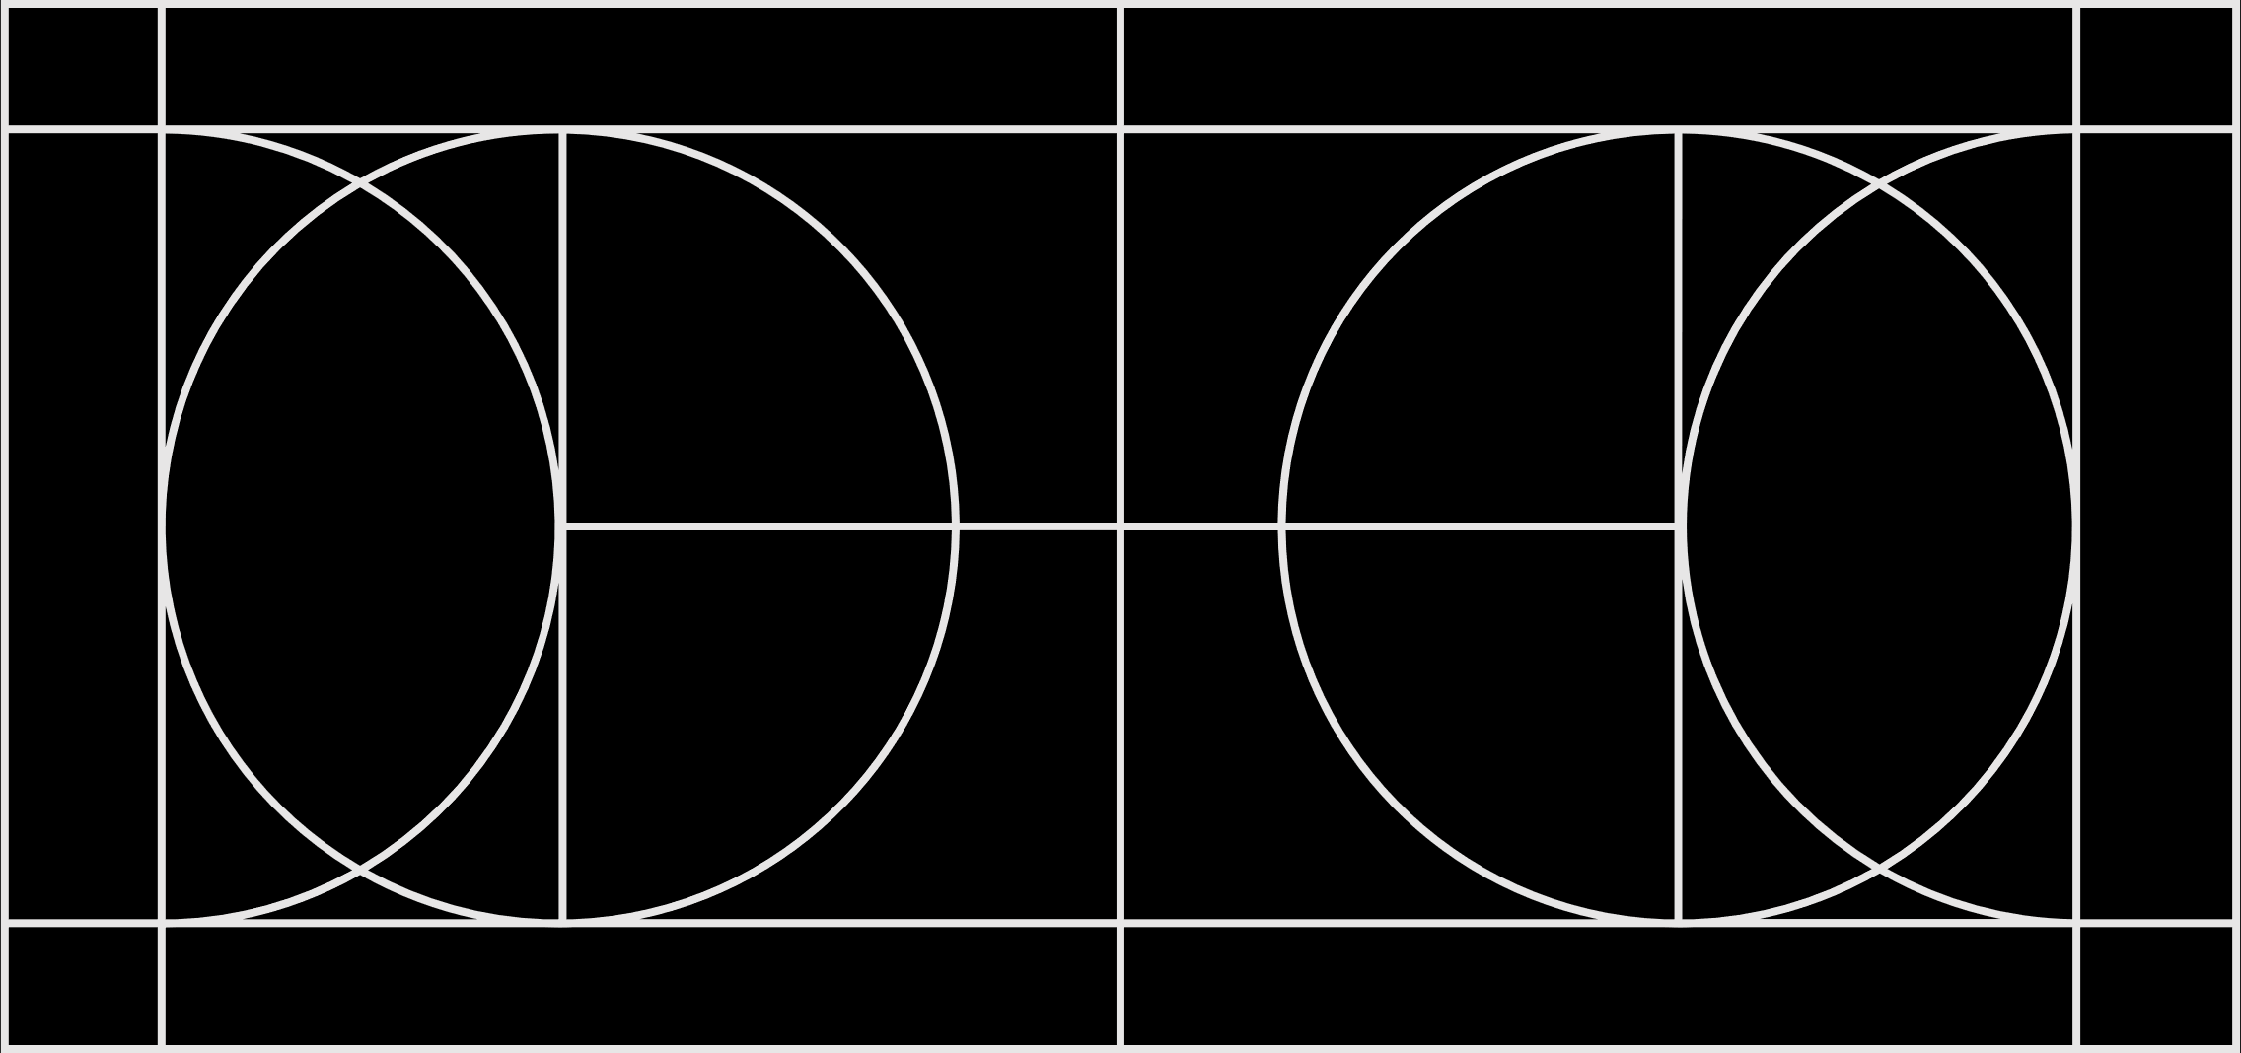
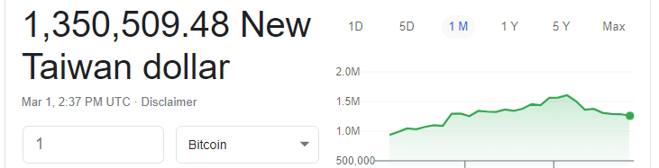
Bitcoin
Introduction

Slide 2
How to use Bitcoin
A bitcoin wallet is required to access the bitcoin system. There are many wallets available on mobile and desktops. Do NOT use a web-based wallet.
There are also hardware wallets and paper wallets
Hardware wallets use a custom-made device stores your keys.
A paper wallet is a printed piece of paper that contains keys and your bitcoin address. DO NOT use a paper wallet generated by a website.
READ https://www.coindesk.com/bitcoinpaperwallet-back-door-missing-funds-research

Slide 3
Cryptography Basics
Hash function
Symmetric Key
Asymmetric Key (also known as public key cryptography)

Slide 4
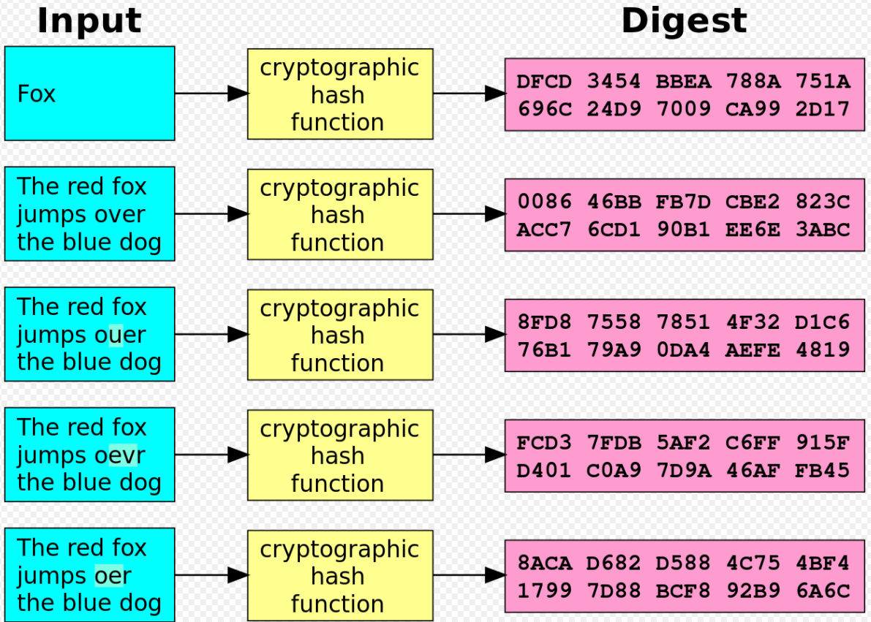
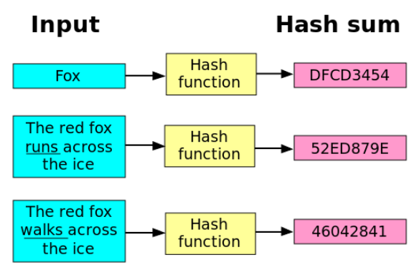
Hash

Slide 5
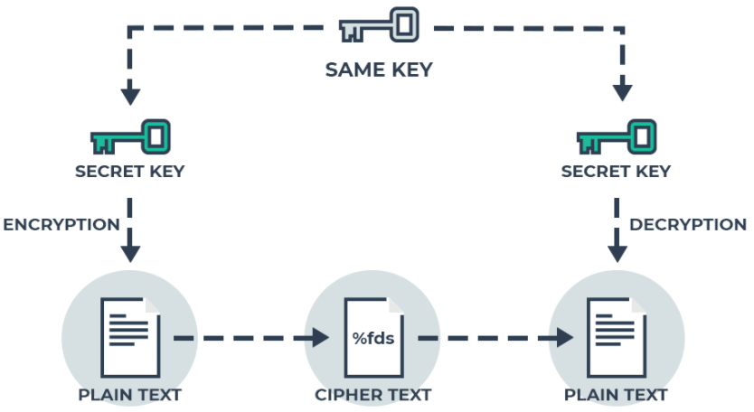
Symmetric Key

Slide 6
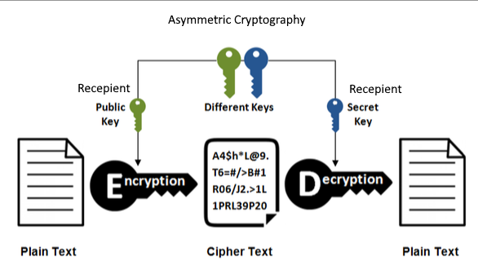
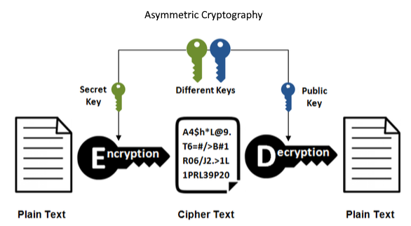
Asymmetric Key

Slide 7
Digital Signature
Document
Document
Hash Digest
Encrypted Hash Digest
Encrypt Hash Digest using Private Key
Encrypted Hash Digest
Receive
Hash Digest
Network
matches
Verified
Send
Hash Digest
Decrypt Hash Digest using Public Key

Slide 8
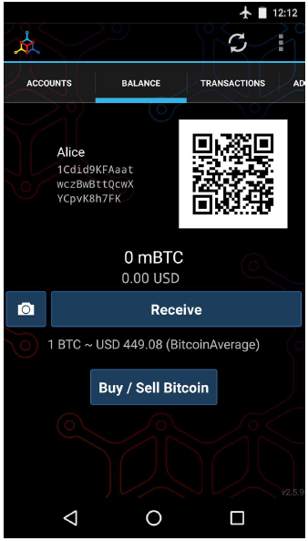
Sending and Receiving
Joe wants to send to Alice some BTC.
Joe opens his wallet select the send function.
Joe requires Alice bitcoin address and the amount to send.
Joe can opt to scan Alice address in QR code so he needn’t type in Alice address: 1Cdid9KFAaatwczBwBttQcwXYCpvK8h7FK.
Joe taps the QR code icon and activates the smartphone camera, scanning the QR code on Alice’s smartphone.
Joe keys in the amount and press Send

Slide 9
Sending and Receiving
Joe’s wallet constructs a transaction that assigns the BTC quantity to the address provided by Alice.
This transaction will be signed by Joe’s private key. This tells the bitcoin network that the owner of the private key (Joe) has authorized a transfer of value to Alice’s address.
As the transaction is transmitted via the peer-to-peer protocol, it quickly propagates across the bitcoin network. In less than a second, most of the well-connected nodes in the network receive the transaction and see Alice’s address for the first time.

Slide 10
Sending and Receiving
Meanwhile, Alice’s wallet is constantly “listening” to published transactions on the bitcoin network, looking for any that match the addresses in her wallets
At first, Alice’s address will show the transaction from Joe as “Unconfirmed.” This means that the transaction has been propagated to the network but has not yet been recorded in the bitcoin transaction ledger, known as the blockchain.
To be confirmed, a transaction must be included in a block and added to the blockchain, which happens every 10 minutes, on average
After some time, Alice’s wallet will confirm that it has received the BTC.

Slide 11
Bitcoin Address
Bitcoin addresses are between 26 and 35 alphanumeric characters long.
There are currently three address formats in use: Pay-to-PubKey-Hash (P2PKH, also known as Legacy address), Pay to script hash (P2SH) and Bech32.
Not all wallets support all three address formats
P2PKH which begins with the number 1 and is case sensitive
1BvBMSEYstWetqTFn5Au4m4GFg7xJaNVN2.
P2SH type starting with the number 3, and is case sensitive
3J98t1WpEZ73CNmQviecrnyiWrnqRhWNLy.
Bech32 type starting with bc1, however is not case sensitive
bc1qar0srrr7xfkvy5l643lydnw9re59gtzzwf5mdq.

Slide 12
Bitcoin Address: P2PKH
P2PKH addresses are the original Bitcoin address format
It is also known as Legacy addresses.
All wallets should support legacy addresses; you should be able to receive Bitcoin sent from a P2SH address to a legacy address

Slide 13
Bitcoin Address: SegWit
There are two types of SegWit addresses. One type (“P2SH”) starts with a ”3” — though not all addresses that start with a 3 are Segwit addresses. The other (“bech32”) starts with “bc1,” and is always a SegWit address.
SegWit is a protocol update that occurred in August 2017 in an attempt to ease the blockchain’s scaling woes
SegWit, or segregated witness splits off signature data from Bitcoin transactions—reducing the size of transaction data that needed to be stored in Bitcoin blocks
https://bitcoinmagazine.com/what-is-bitcoin/what-is-segwit

Slide 14
Private Keys
The private key must remain secret at all times because revealing it to third parties is equivalent to giving them control over the bitcoins secured by that key. The private key must also be backed up and protected from accidental loss, because if it’s lost it cannot be recovered and the funds secured by it are forever lost, too.” ― Andreas M. Antonopoulos, Mastering Bitcoin
“If you don’t own your private key, you don’t own your bitcoins.”

Slide 15
Keys and Addresses
Ownership of bitcoin is established through digital keys, bitcoin addresses, and digital signatures.
The digital keys are not actually stored in the network, but are instead created and stored by users in a file, or simple database, called a wallet.
Most bitcoin transactions requires a valid digital signature to be included in the blockchain, which can only be generated with a secret key; therefore, anyone with a copy of that key has control of the bitcoin.

Slide 16
Witness
The digital signature used to spend funds is also referred to as a witness, a term used in cryptography.
The witness data in a bitcoin transaction testifies to the true ownership of the funds being spent.

Slide 17
Keys
Keys come in pairs consisting of a private (secret) key and a public key.
Think of the public key as similar to a bank account number and the private key as similar to the secret PIN, or signature on a check, that provides control over the account.
These digital keys are very rarely seen by the users of bitcoin.
For the most part, they are stored inside the wallet file and managed by the bitcoin wallet software.

Slide 18
Keys and Address
In the payment portion of a bitcoin transaction, the recipient’s public key is represented by its digital fingerprint, called a bitcoin address, which is used in the same way as the beneficiary name on a check (i.e., “Pay to the order of ”).
The bitcoin private key is just a number. You can pick your private keys randomly using just a coin, pencil, and paper: toss a coin 256 times and you have the binary digits of a random private key you can use in a bitcoin wallet.
The public key can then be generated from the private key but not vice-versa
The bitcoin address is generated from the public key but it doesn’t the other way

Slide 19
Keys and Address
The size of bitcoin’s private key space, (2²⁵⁶) is an unfathomably large number. It is approximately 1077 in decimal. For comparison, the visible universe is estimated to contain 1080 atoms.
It is 256 bits long and can be written as a 64 hexadecimal digits, eg.
1E99423A4ED27608A15A2616A2B0E9E52CED330AC530EDCC32C8FFC6A526AEDD
Address = RIPEMD160 (SHA256(K))

Slide 20
Public Key Cryptography
Also called asymmetric cryptography
It’s not used to encrypt transactions or messages.
Rather, the useful property of asymmetric cryptography is the ability to generate digital signatures.
A private key can be applied to the digital fingerprint of a transaction to produce a numerical signature.
This signature can only be produced by someone with knowledge of the private key. However, anyone with access to the public key and the transaction fingerprint can use them to verify the signature.

Slide 21
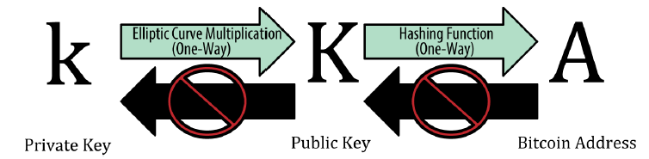
Public Key Cryptography
A bitcoin wallet contains a collection of key pairs, each consisting of a private key and a public key.
The private key (k) is a number, usually picked at random. From the private key, we use elliptic curve multiplication, a one-way cryptographic function, to generate a public key (K).
From the public key (K), we use a one-way cryptographic hash function to generate a bitcoin address (A).

Slide 22
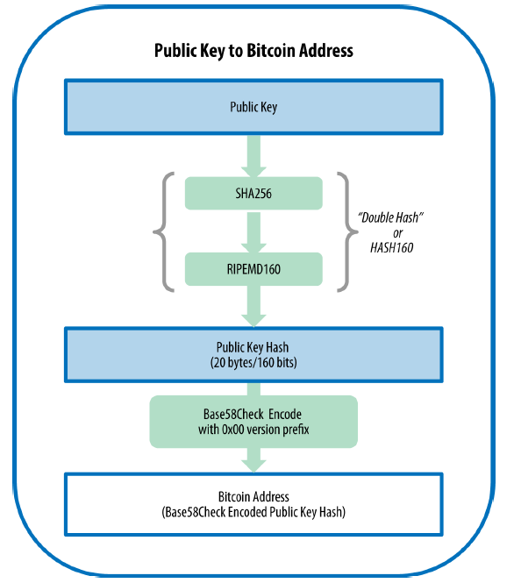
Bitcoin Address

Slide 23
Wallets
Bitcoin wallets contain keys, not coins. Each user has a wallet containing keys.
Wallets are really keychains containing pairs of private/public keys
Users sign transactions with the keys, thereby proving they own the transaction outputs (their coins).
The coins are stored on the blockchain in the form of transaction outputs

Slide 24
Wallets
Commonly used is a deterministic wallet, where all the keys are derived from a single master key, known as the seed.
All the keys in this type of wallet are related to each other and can be generated again if one has the original seed.
Deterministic wallets are initialized from a seed. Private keys that are all derived from a common seed, through the use of a one-way hash function.
To make these easier to use, seeds are encoded as English words, also known as mnemonic code words: army van defense carry jealous true garbage claim echo media make crunch

Slide 25
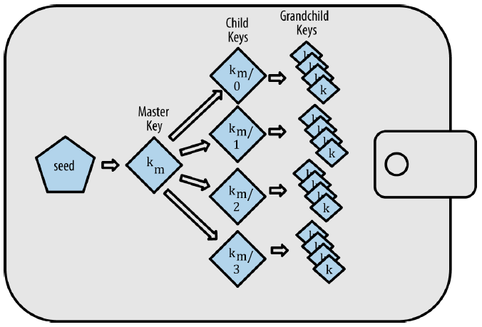
Wallets

Slide 26
Mnemonic words (BIP-39)
Mnemonic code words are word sequences that represent (encode) a random number used as a seed to derive a deterministic wallet.
A wallet application that implements deterministic wallets with mnemonic words will show the user a sequence of 12 to 24 words when first creating a wallet.
Example: army van defense carry jealous true garbage claim echo media make crunch
Webpage to try: https://iancoleman.io/bip39/

Slide 27
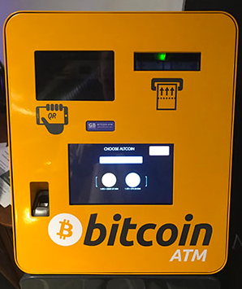
How to Get Bitcoin
Purchase through a website e.g. binance.com using credit card or bank transfer
Purchase through ATM.
Use a classified service such as localbitcoins.com to find a seller in your area to buy bitcoin for cash in an in-person transaction.

Slide 28
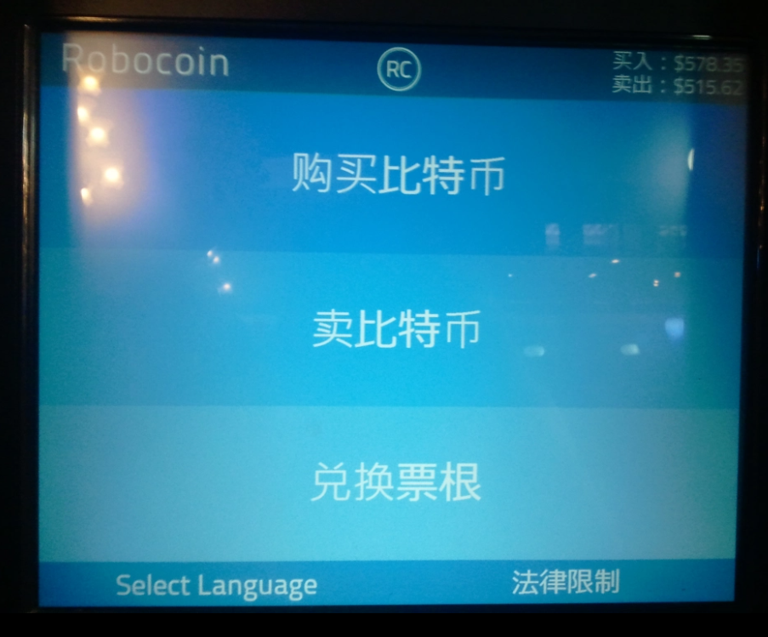
Bitcoin ATM
See https://www.youtube.com/watch?v=DcX_OK13lxU&feature=youtu.be

Slide 29
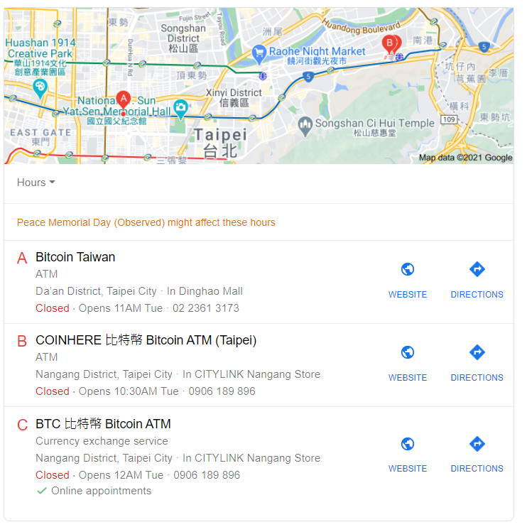
Taipei ATM

Slide 30
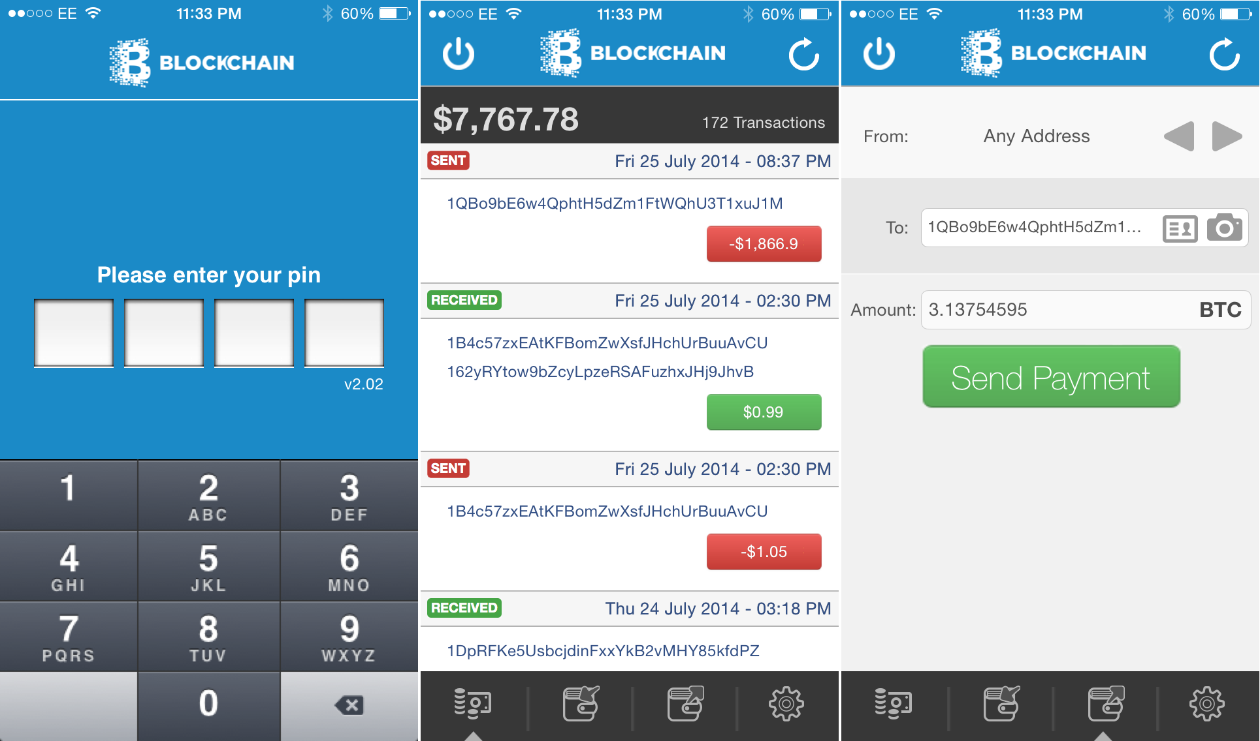
Mobile Wallet App

Slide 31
Testnet
Many systems have a testnet where you can perform test transactions using coins that have no value.
These coins can be obtain via “faucets” such as at: https://coinfaucet.eu/en/btc-testnet/
https://testnet-faucet.mempool.co/
You can also download an app for testnet. Search for Testnet Wallet on Google Play.

Slide 32
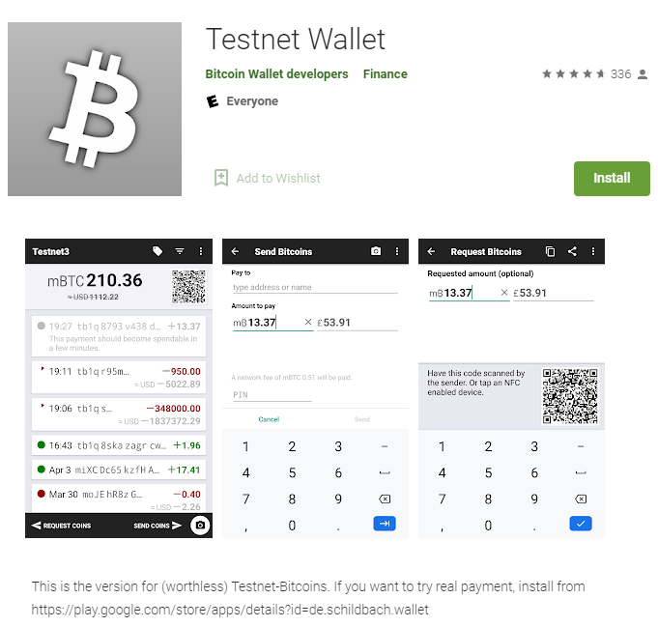
Testnet App
Available on Google Play

Slide 33
Desktop Wallets
Electrum - https://electrum.org/#download
Before use, you need to verify the file signature.
Do not download Electrum from another source than electrum.org, and learn to verify GPG signatures.
Electrum is a lightweight Bitcoin wallet.
For security you can install Electrum on a thumbdrive with the Tails OS. The latest Tails OS comes with Electrum.

Slide 34
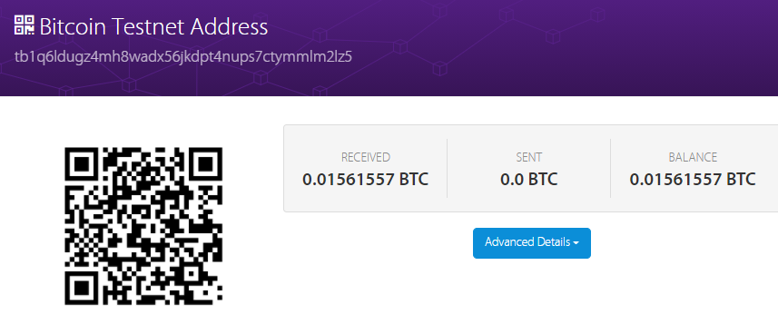
Block Explorer
The block explorer application the recent transaction and balance of the address: tb1q6ldugz4mh8wadx56jkdpt4nups7ctymmlm2lz5
“address.” This is a
https://live.blockcypher.com/btc-testnet/

Slide 35
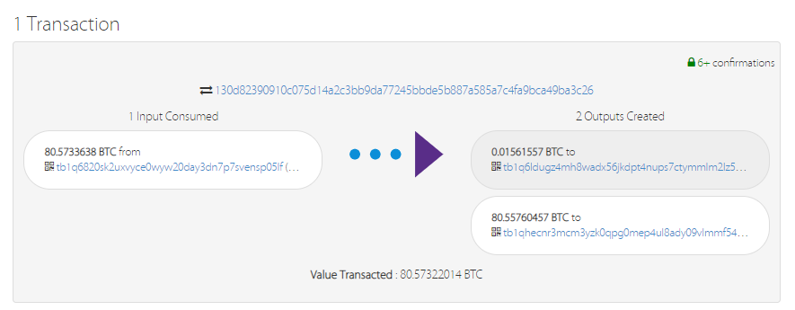
Block Explorer
It captures the transaction from 1 address to another

Slide 36
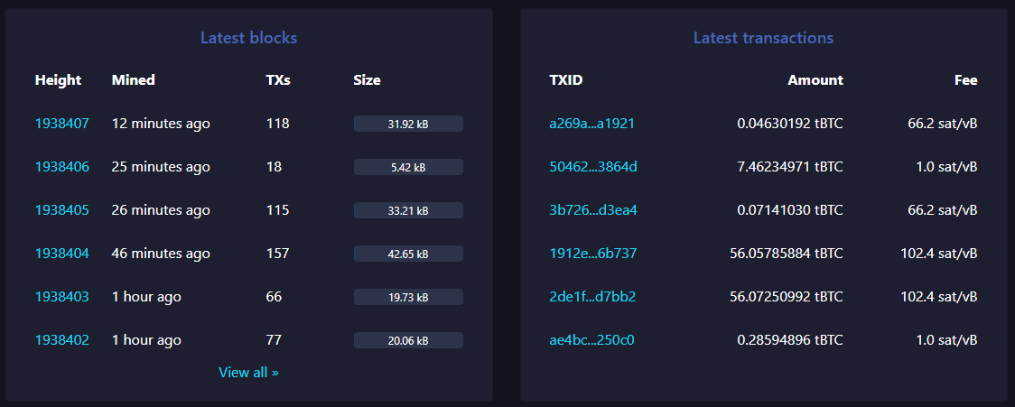
Block Explorer
The transactions on the blockchain can be viewed using a block explorer

